Slide 1
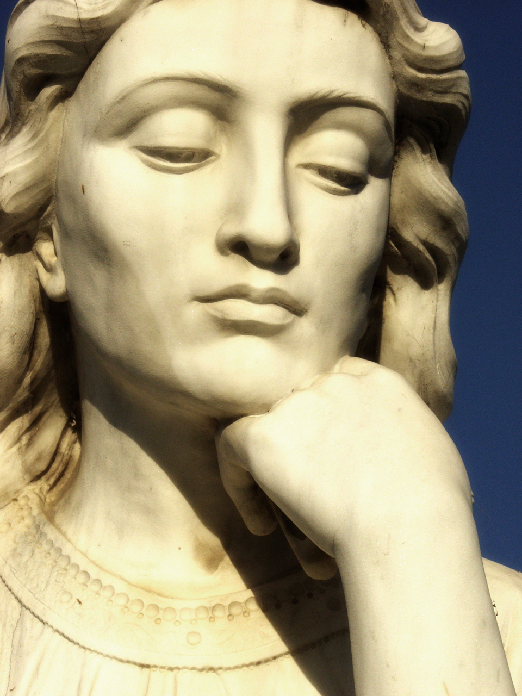
How to Write and Speak Insightfully
I.I.I Series
(Issue, Influences, Implications)

Slide 2
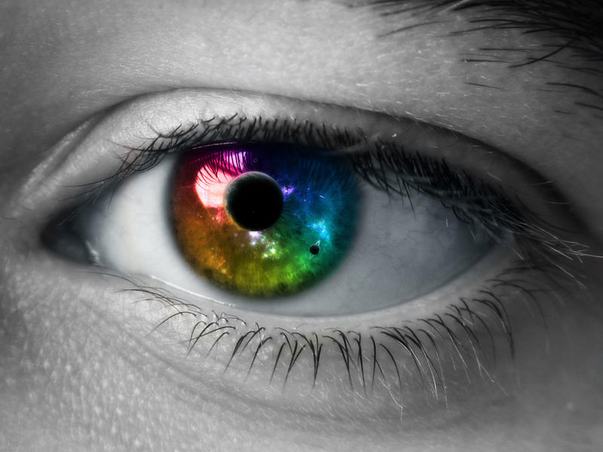
That was DEEEEEEEEP!!!!
What does it mean to be insightful?
Showing a deep understanding
Having a clear perspective
Being able to articulate the context behind a topic

Slide 3
How we show our insight on a topic: Claim Sentences
A claim is your stance or position on a topic or issue (without using “I”).
Claims are argumentative.
Claims are specific and concise.
Claims are SIGNIFICANT points.
Claims show the goal, scope, or focus of your writing or speech.
Claims must be supported by evidence, example, quotes..etc

Slide 4
Organizing Our Ideas
What I.I.I Stands For | Definition
The Issue | The problem or topic
The Influences | Why the problem (or topic at hand) exist. THE CAUSE
The Implications | What is or may be the result(s) of the problem. THE EFFECT

Slide 5
Reading or Listening for the Issue
Step 1: Circle the subject (What and Who)
Be specific about WHAT- environmental, economic, familial, political…etc
Be specific about WHO- race, class, gender, age, nationality, sexuality, career, organizational affiliation…etc
Step 2: Circle contextual information (When and Where)
Be specific- location, time period, cultural climate..etc
Step 3: Underline adjectives and quotes that reveal HOW the author or speaker is communicating about the subject.

Slide 6
Writing about the Issue
Insightful Claim Sentences for Argumentative Writing | Insightful Claim Sentences for Literary Analyses (Usually based on the central idea of the reading)
Instagram has proven to be a significant force in the Black Lives Matter movement. | The challenges of dealing with peer pressure are highlighted in Dr. Seuss's The Cat in The Hat.
Despite the risk related to plastic surgery, many American women continue to seek breast augmentation to meet the American standards of beauty. | The story of Beowulf emphasizes how arrogance and pride can lead to one’s downfall.

Slide 7
Reading for the Influences
Step 1: Underline transitional phrases that show cause
Step 2: Draw an arrow and underline the examples that relate to the cause
Step 3: Note the type of influence
Social | Physical or Biological | Economic | Media | Environmental
Communication and Messages. Interactions with family, friends, and others. Cultural Messages | Physical abilities and disabilities. Cognitive (Brain Function) Hormones | Income Class Living Condition | Art, Visual Images Advertisements Social Media Entertainment | Physical Location Climate, Weather Pollution Living Condition

Slide 8
Writing about the Influence
Insightful Claim Sentences for Argumentative Writing | Insightful Claim Sentences for Literary Analyses
Many people have used Instagram to bring awareness to police brutality against Black men, due to the increasing number of cases being reported. | The political climate during World War II may have influenced Dr. Seuss’ writing.
Having full breast and curves is often part of the feminine ideal in American culture. | The hypermasculine nature of Beowulf is emphasized throughout the text by the use of figurative language.

Slide 9
Reading for Implications
Step 1: Underline transitional phrases that show effect
Step 2: Draw an arrow and underline the examples that relate to the effect
Step 3: Note the type of influence
Social | Physical or Biological | Economic | Psychological and Emotional | Environmental
The way we communicate The way we treat others Our Messages and Interactions | The way we treat others (physical interactions) Changing personal aesthetics | Job Opportunities Wage, Income Living Condition | Thought Process Your World View Your Perspective Your feelings and emotions | Physical Location Climate, Weather Pollution Living Condition

Slide 10
Writing about the implications
Insightful Claim Sentences for Argumentative Writing | Insightful Claim Sentences for Literary Analyses
The Black Lives Matter movement has pushed for more accountability among law enforcement agents. | Sam I am’s refusal to conform was emphasized through the use of rhyme.
A major physical implication related to breast augmentation, is the risk of internal infections. | Imagery played an important role in helping the reader picture the story’s setting.

Slide 11
Video Analysis Practice
Copy the cause and effect thinking map
Use identify the issue, influence, and implications for each text.

